Slide 1


TEST TOOL SIGNAL GENERATOR FOR EVA BENCHTEST
Student: Jianyu Chen
Data: April 12th, 2017
1st examiner: J.A. Verhage
2nd examiner: W. Huibregtse
In-company mentor: John van Zwam

Slide 2
Content of presentation
Designer
Assignment
Ideas
Result

Slide 3
Introduction of designer
Name: Jianyu CHEN
School: HZ University of Applied Sciences &
Shanghai Maritime University (joint program)
Major: Mechatronics (HZ)
Electrical engineering and intelligent control (SMU)

Slide 4
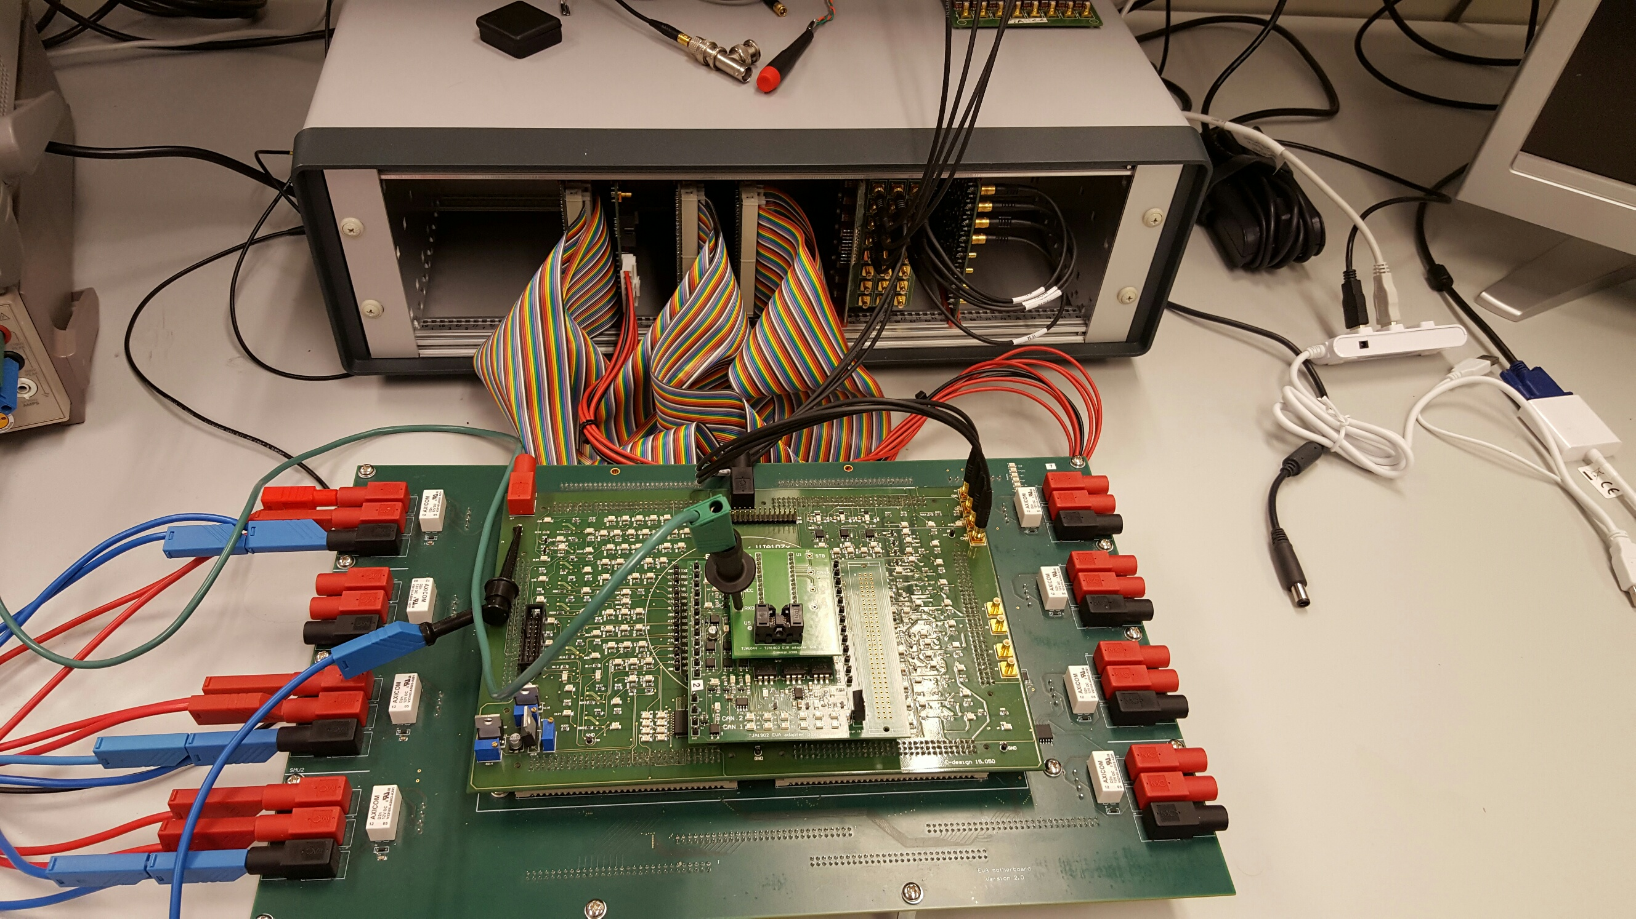
EVA
Aim to test chips
Consist of 3 part
Backplane
Motherboard
Daughterboard

Slide 5
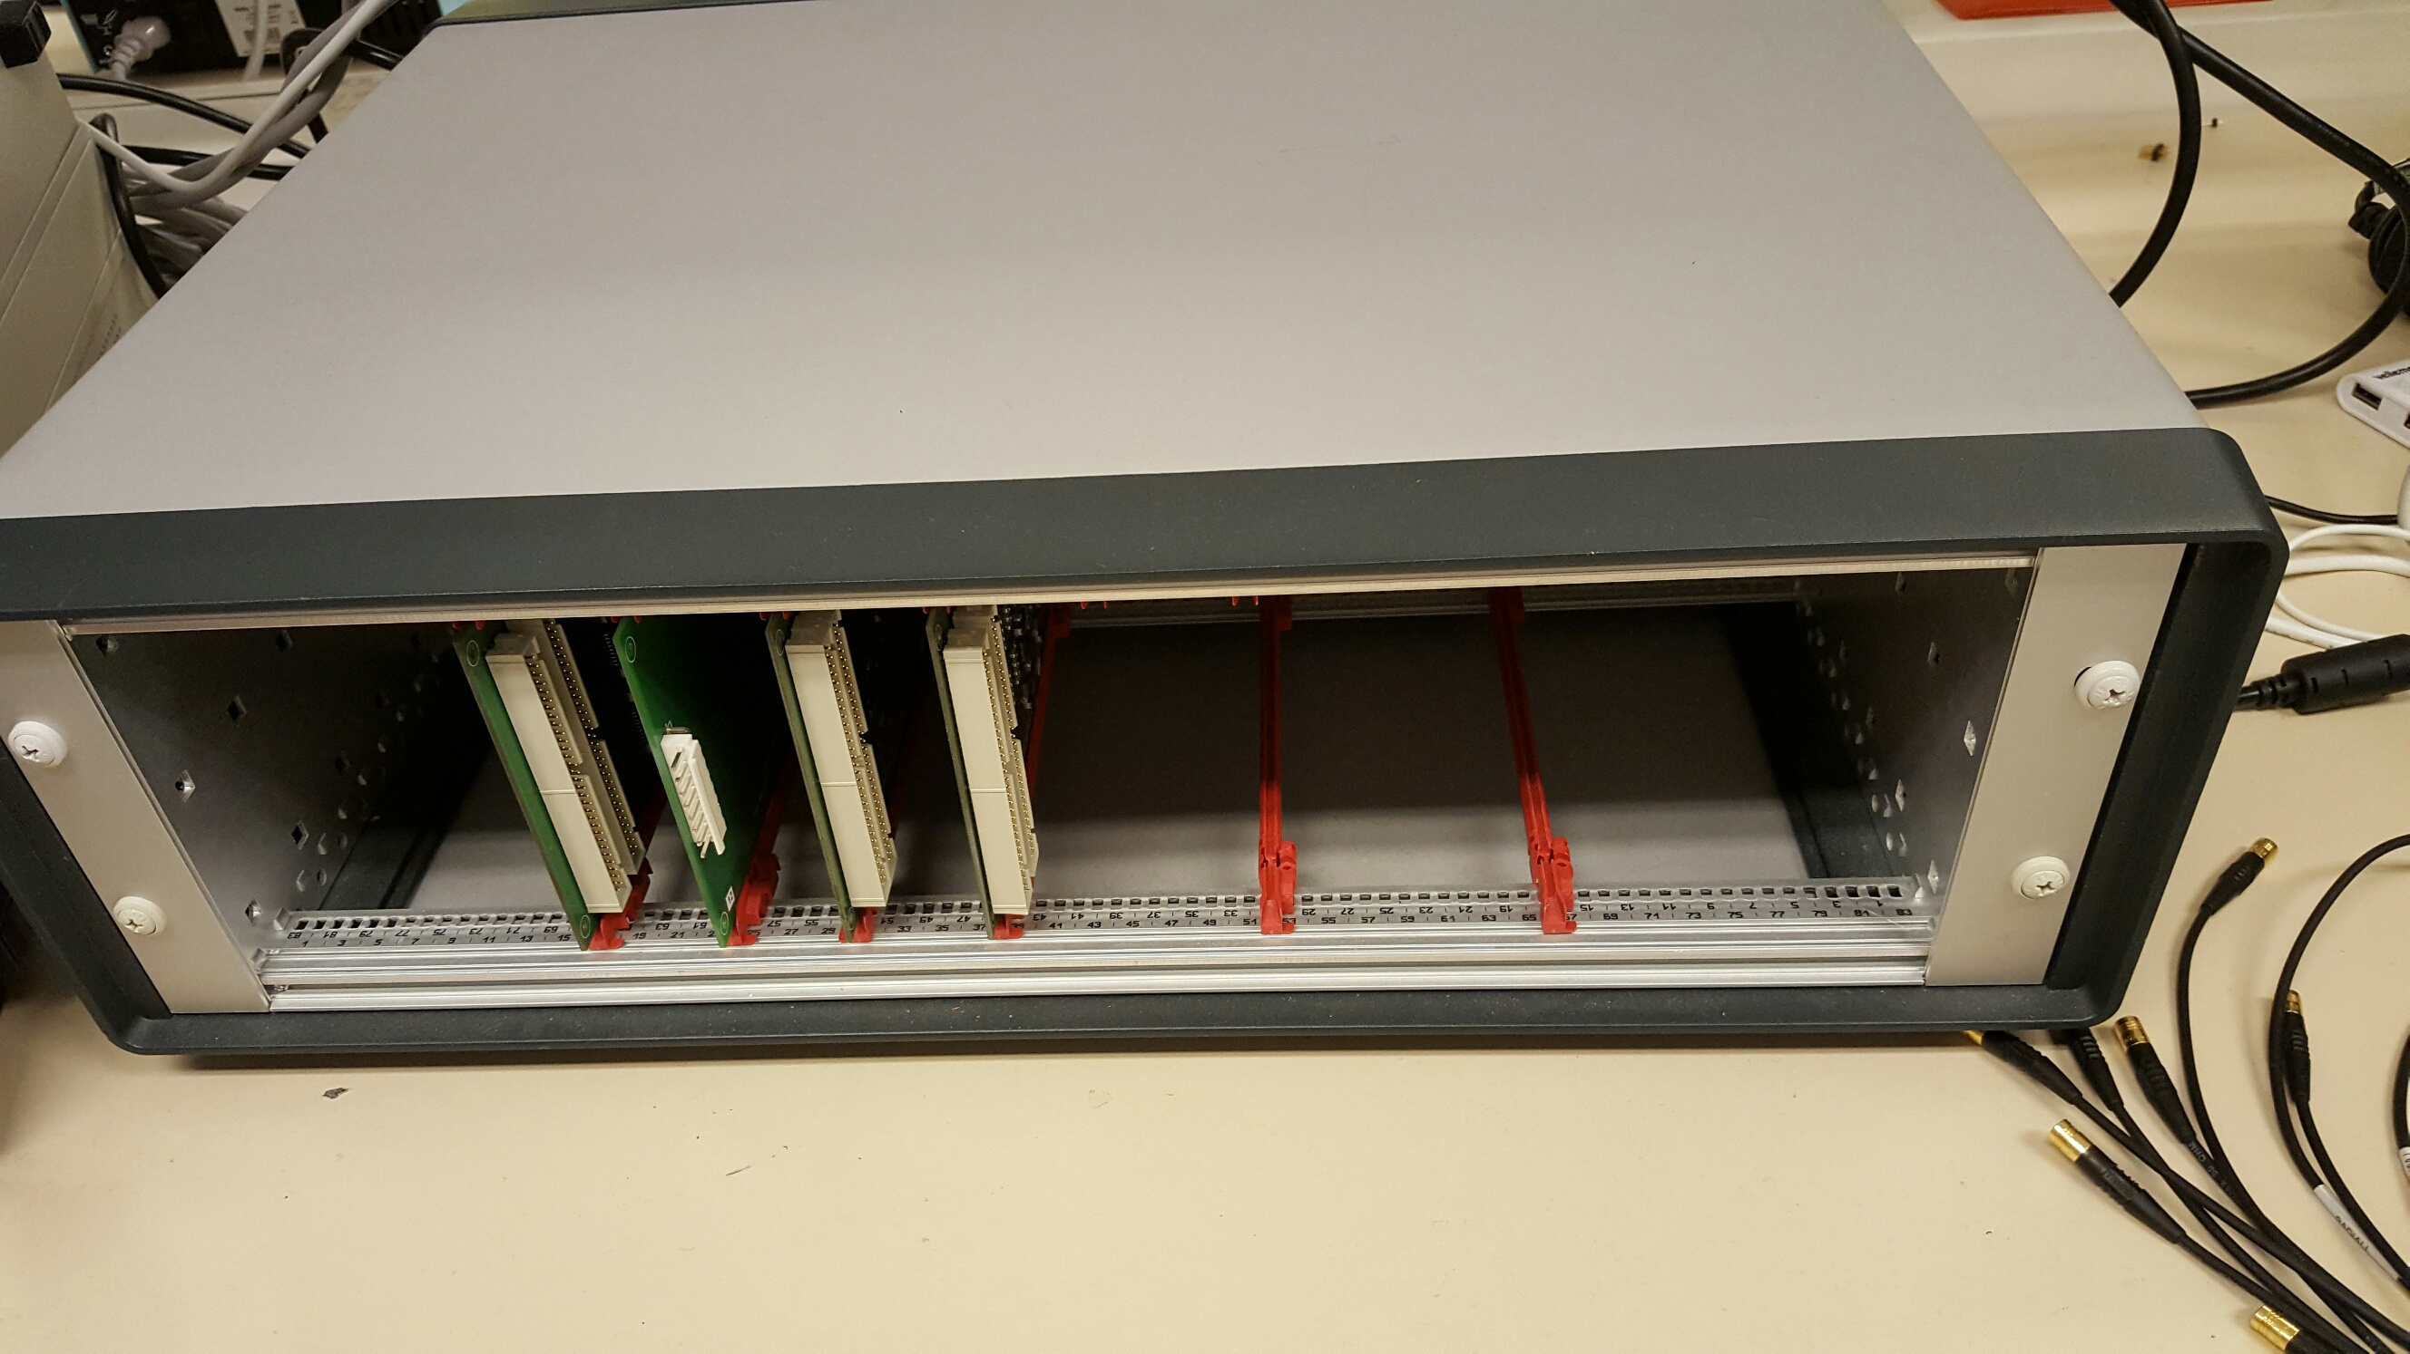
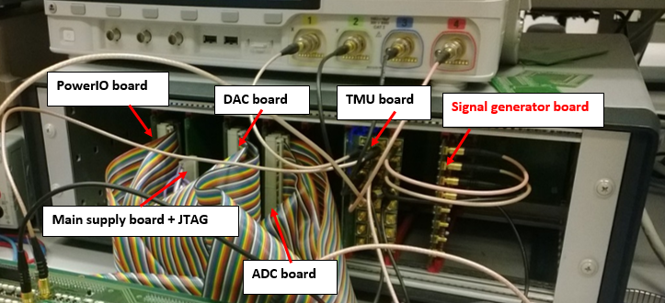
Backplane
Part of EVA
Different kinds of boards can be plugged in

Slide 6
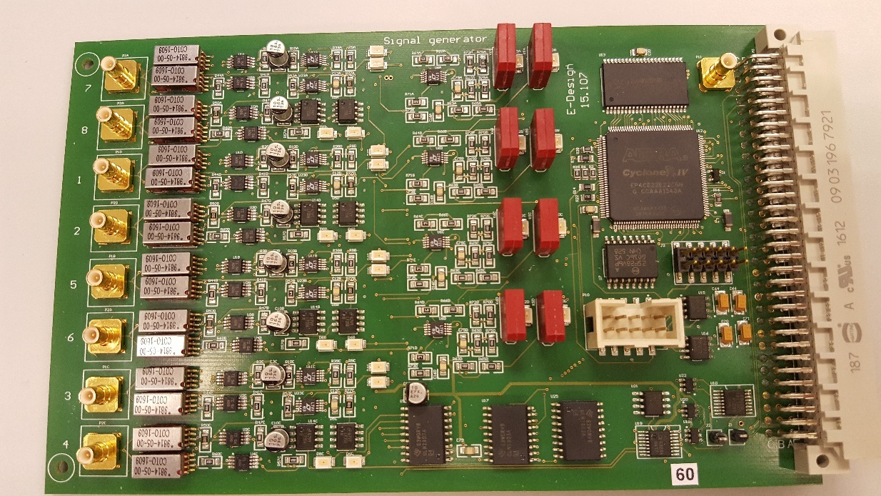
Signal generator board
8 Channels
Square waveform output
Output resistance: 50Ω
Output voltage: 1.5V to 10V
Output frequency: 1Hz to 50MHz
I²C interface
Notes:
Has 8 channels.

Slide 7
Requirements
Test the peak-to-peak voltage
Test the duty cycle
Test the frequency
Consist of test board and computer software
Controlled by computer

Slide 8
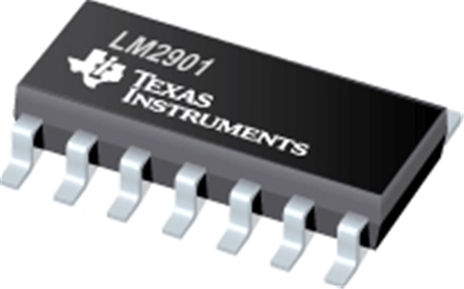
LM2901PW analog comparator
Open-drain output
Input voltage: 2V to 36V
Pull up to 3.3V
4-channel
Notes:
Before the introduction of my final idea

Slide 9
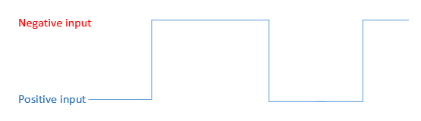
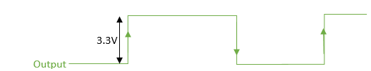
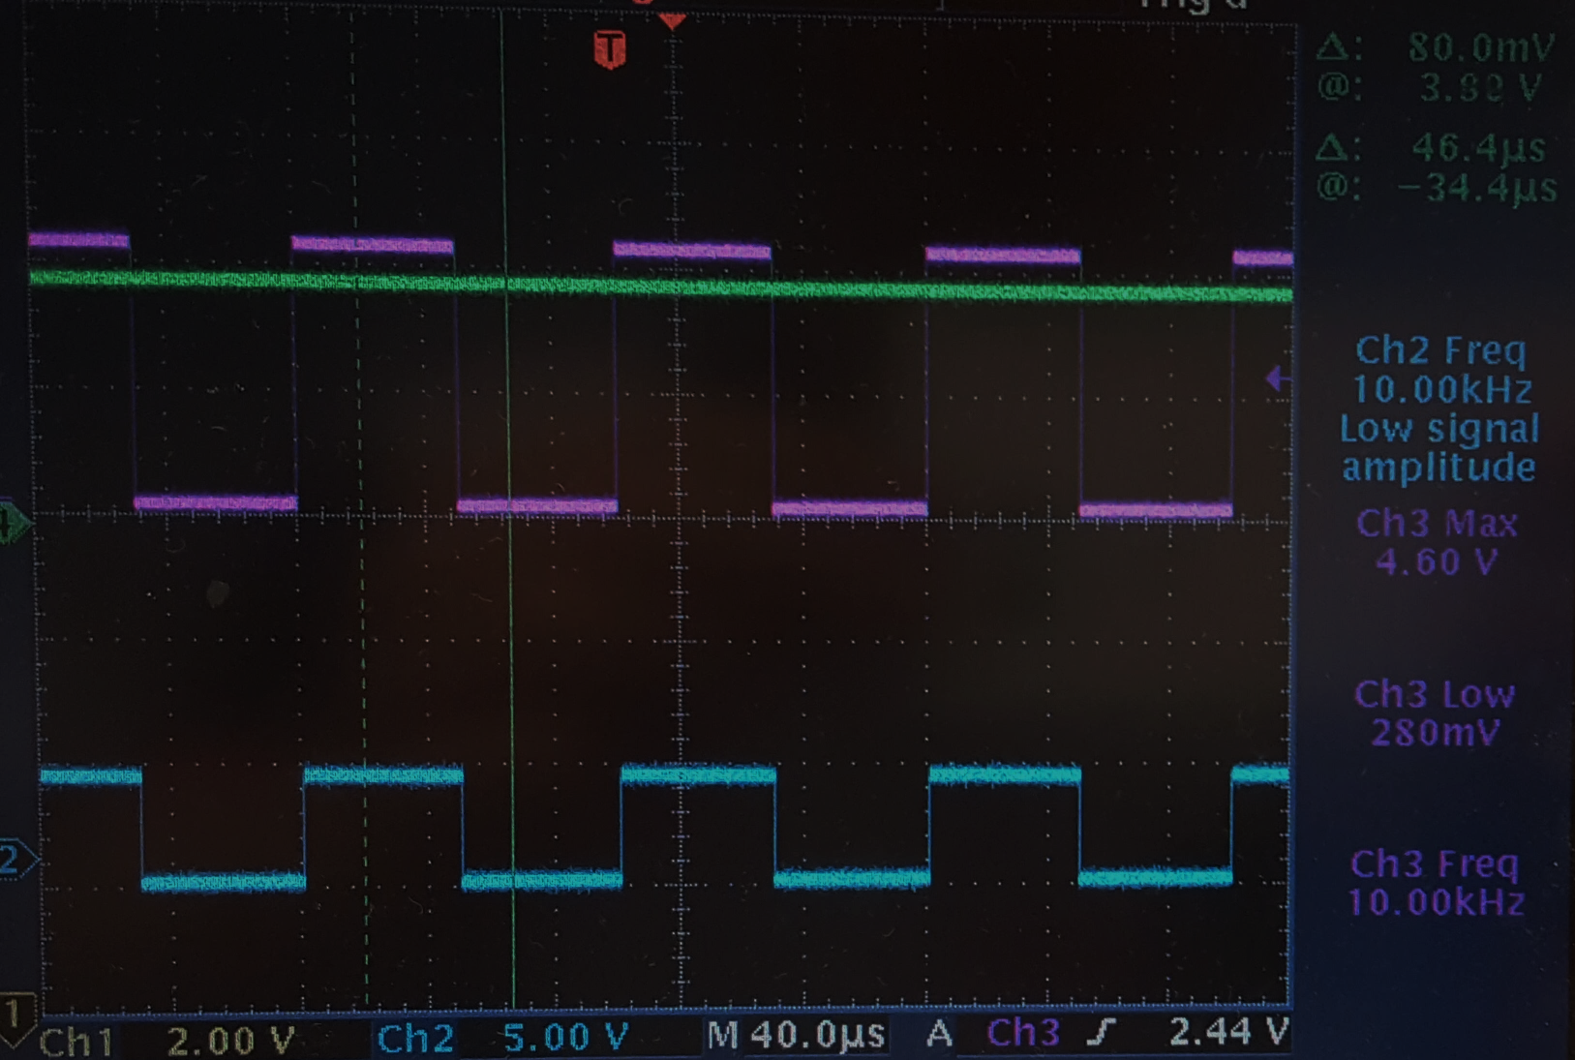
Test peak-to-peak voltage
Analog comparator
Use DAC to generate a voltage which is 0.3 lower than desired voltage
Output should be square waveform of 3.3V
Use MCU to read the output
Notes:
Oscilloscope. in this

Slide 10
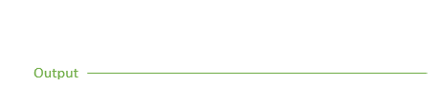
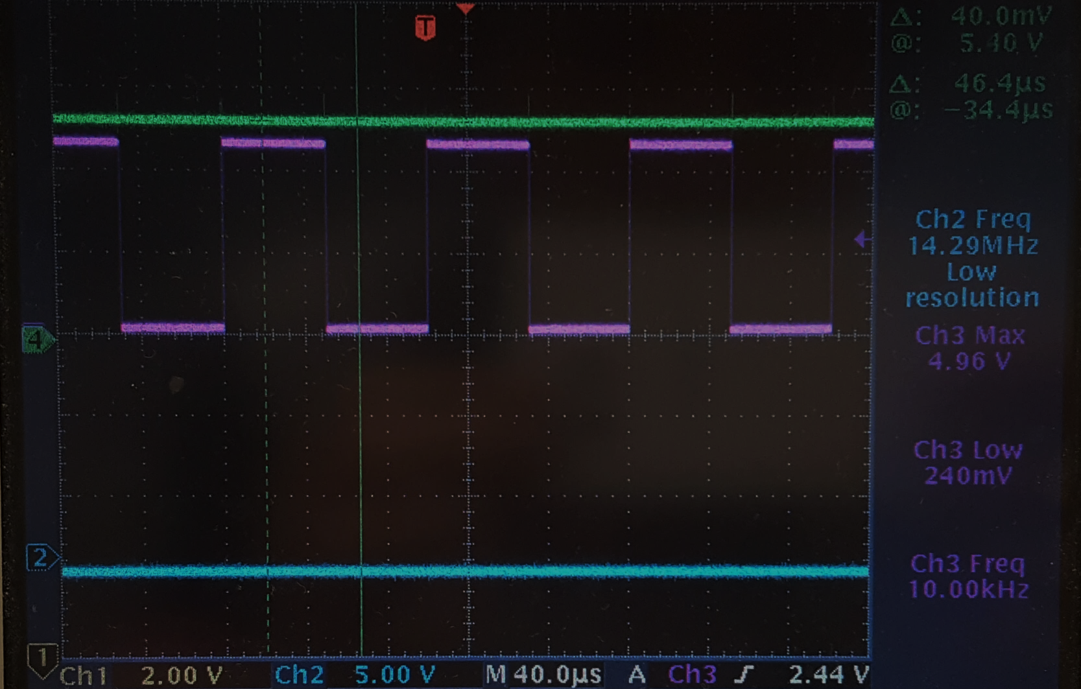
Test peak-to-peak voltage
Use DAC to generate a voltage which is 0.3V higher than desired voltage
Output should be low
Use MCU to read the output

Slide 11
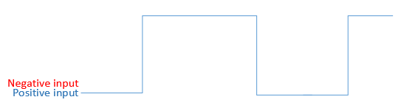
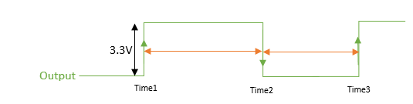
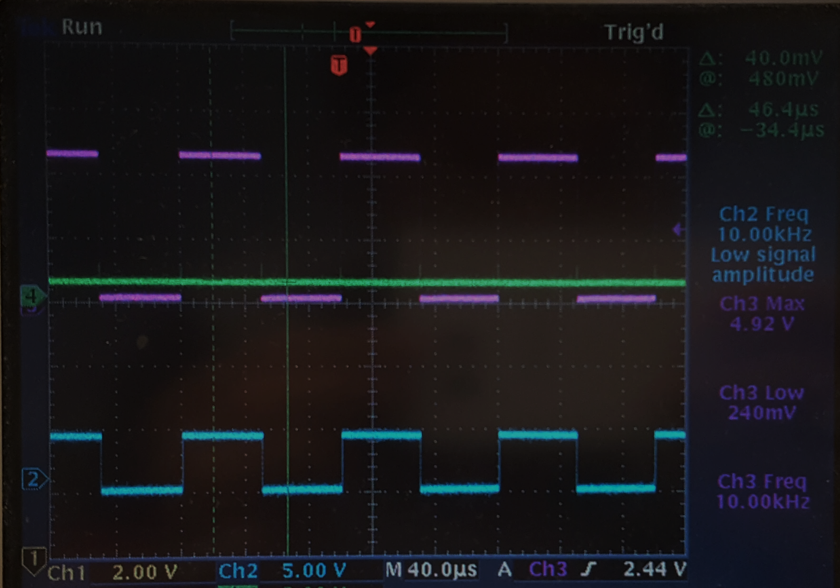
Test frequency and duty cycle
Generate 0.5V
Output should be square waveform of 3.3V
Use MCU to read the output
Send time1 time2 and time3 to computer

Slide 12
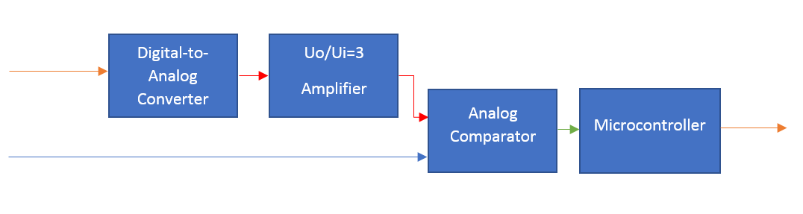
Testing system
DAC generate a voltage from 1V to 3.3V
Op-Amp amplify the voltage
Analog compare two voltage
Microcontroller read the output of analog comparator
square waveform

Slide 13
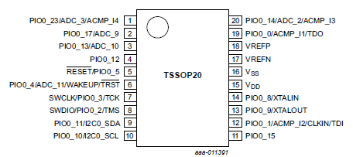
LPC824 Microcontroller
Designed by NXP
Based on ARM Cortex M0+
8 pin interrupts (rising edge and failing edge)
I²C interface
Maximum clock: 30Mhz
31-bit multi-rate timer
3.3V power supply

Slide 14
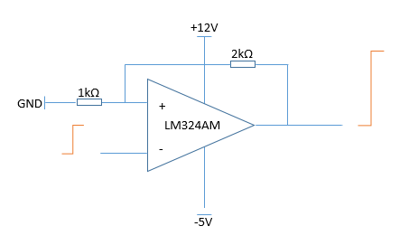
Digital-to-analog Converter
DAC6578SPW generates a voltage from 0V to 3.3V
Op-Amp amplify the voltage to 3 times

Slide 15
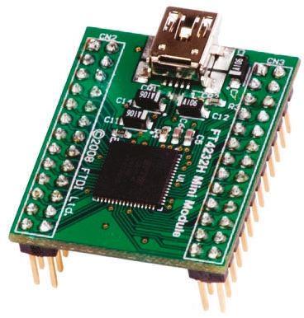
FT4232H Module
Transfer USB to I²C
Transfer USB to GPIO
Communicate between computer and MCU
Communicate between computer and signal generator board
Reset MCU and DAC
Notes:
This is FT4232 module, it is used a lot in the company. The pins on it can work as I2C or GPIO and can be controlled by the USB port. So, in the project, it will be used for the communication between computer and test board and between computer and signal generators board
I connect the GPIO to reset pins of MCU and DAC

Slide 16
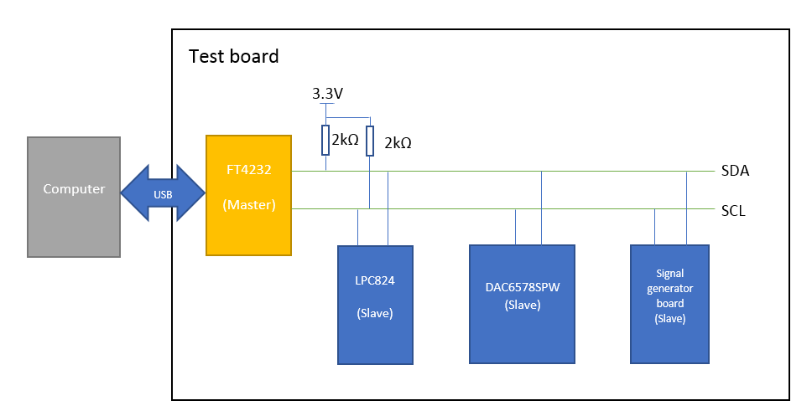
Data exchange
Between computer and FT4232 via USB
Among components on board via I²C
I²C is pulled up to 3.3V by 2kΩ pull-up resistors
Notes:
In this project, the computer will communicate with FT4232 by usb, and FT 4232 will change the data from usb into i2c. In my board, the i2c will be pulled up to 3.3v by 2kohm resistors. In the I2c, ft 4232 works as master and another components slaves

Slide 17
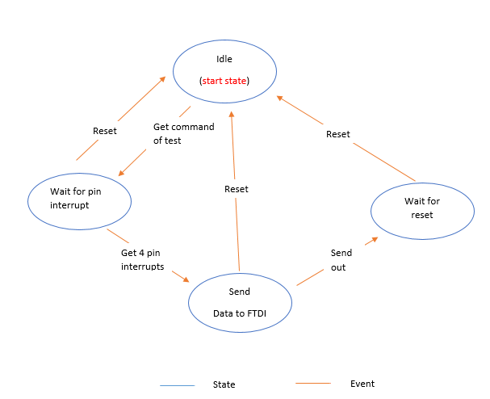
Software of microcontroller
Receive command from FT4232
Send back data if receive interrupt
Be reset before EVERY test
Notes:
After receiving a command from computer, it will be ready to receive pin interrupts
It is a very simple structure because……
Almost no mistake will happen on it

Slide 18
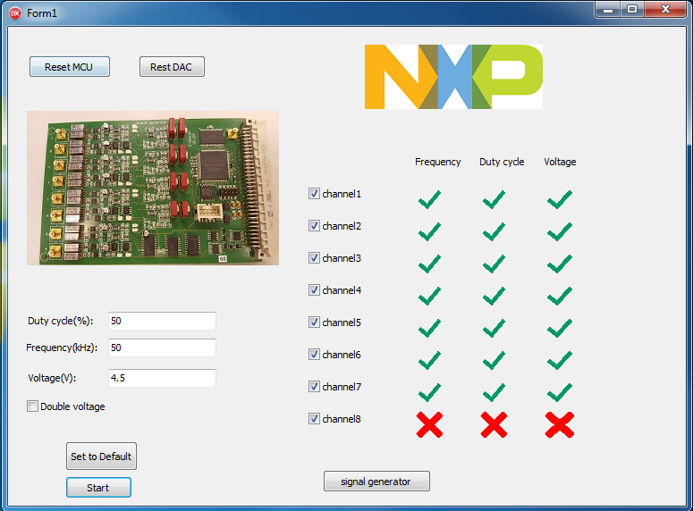
Computer software
Change testing frequency, voltage and channels
Show the test result
Notes:
This is my computer program, it is programmed in Delphi. There are also some existing libraries in company. So programming in Delphi will be easier. And Delphi is also easy to maintain for my colleagues, in the future, maybe my program will be improved or some functions of my program may be used in other programming. This program can be used to work with breadboard to test the channel 7. some components on this software are for the test and calibration, they will be removed in the finally program.

Slide 19
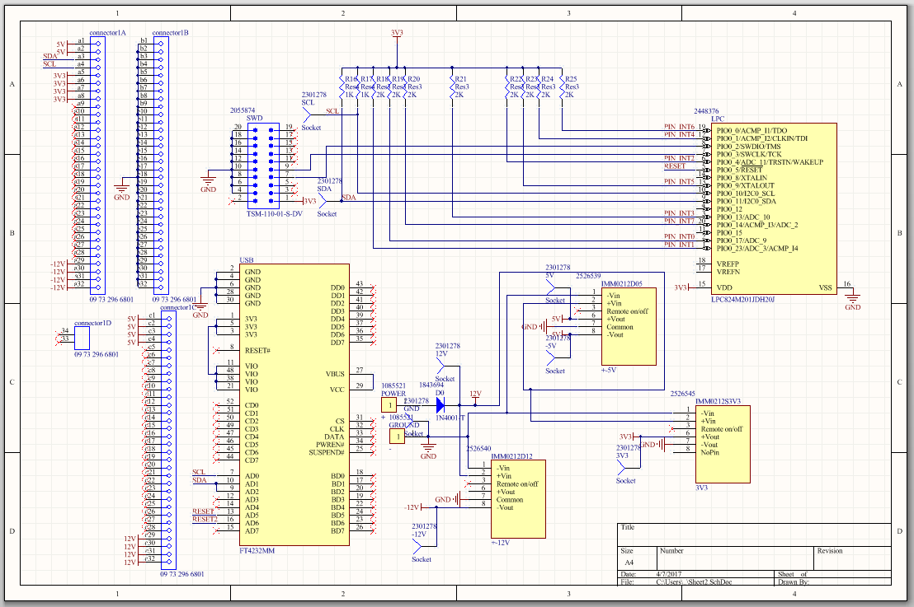
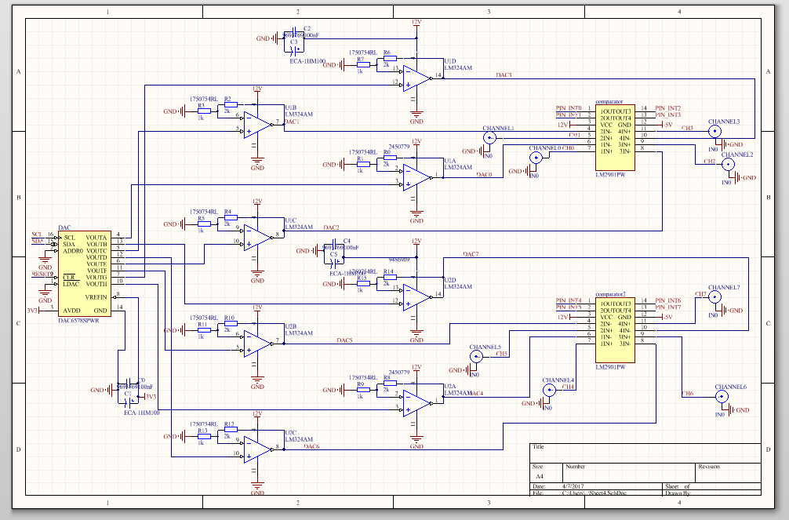
Schematic of the design
Finished

Slide 20
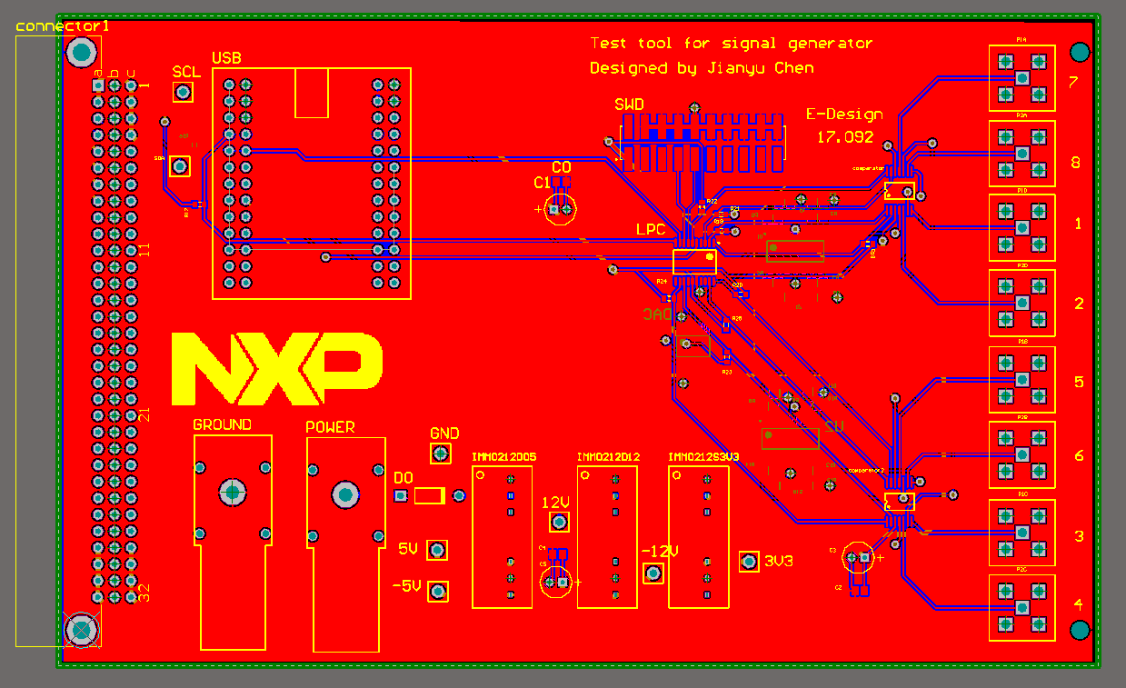
PCB of the design
4 layers board
Polygon pour
Finished
Notes:
Polygon pour

Slide 21
Any questions?

Slide 22
Thank you for your attention

